Slide 1
Introduction to Community Engagement Module
Michael Le
Sharon Rose
Naomi Wortis

Slide 2
Intro to Partner ?

Slide 3
Outline
Define CE v. Intro to CE
SDH
Cultural Humility
Principles of Comm Partnership
Intro to UCSF Resources
Notes:
Each bullet point animated entry

Slide 4
Objectives

Slide 5
Introduction to community engagement
Section I
Notes:
Or call this section “definitions”?

Slide 6
Social Determinants of Health and COPC Model
Section II

Slide 7
What is community engagement?
Introduction:
Community:
Community engagement:
Community-engaged scholarship:

Slide 8
Video placeholder

Slide 9
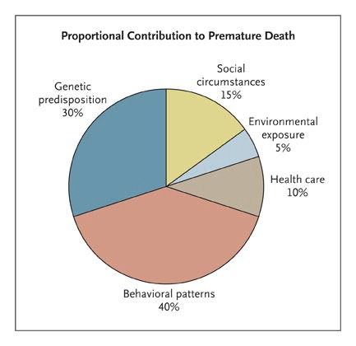
Social Determinants of Health
Notes:
Presenter slide: narrated powerpoint
Narration:
Many different factors determine the health of an individual
A relatively small subset of these factors is influenced by traditional health care (10%)
Health professionals can play an important role in influencing the social determinants of health: social circumstances, environmental exposure, and behavioral patterns
Community engagement is a good way of doing this
Source:
Schroeder, Steven A., We Can Do Better -- Improving the Health of the American People, N Engl J Med 2007 357: 1221-1228
Figure 1. Determinants of Health and Their Contribution to Premature Death. Adapted from McGinnis et al.

Slide 10
COPC Model
Community Partnership
Identify & Characterize Community
Assess Community Needs & Resources
Develop & Implement Intervention
Evaluate Intervention
Notes:
Presenter slide: narrated powerpoint→ Michael set up two possible formats
Narration:
One example of a model for community engagement by health professionals is the Community-Oriented Primary Care (COPC) model, developed by Sydney and Emily Kark
In this model, health professionals:
Identify a community with which they wish to work
Form a partnership with one or more stakeholders in that community and with those partners:
Assess needs and resources of the community
Implement an intervention
Evaluate that intervention

Slide 11
Case Example re SDH/COPC
Partners discuss how their partnership addresses social determinants of health
Partners discuss how their partnership follows COPC model
Notes:
Engage slide: Maybe two video options:
Example partnership describes how their partnership addresses social determinants of health
Example partnership describes how their partnership follows COPC model (if it does)

Slide 12
Defining partner roles
Section V

Slide 13
Partnership Clarity
Who are we separately? What are our missions/goals?
Who are we together? Do we have a shared mission/goal?
How will we agree to proceed?
What will we do together?
What are our respective roles?
How will we keep communication open?
What will we both get out of this partnership?
How will we share power and/or redress power imbalances?
Notes:
Presenter slide: narrated powerpoint
Clarify roles- be clear about what you can and can’t do
Spend regular face time
Budget fairly – Money talks volumes about your perception of their value
Redress power imbalance (i.e. meet at their site)

Slide 14
Support for Partnership Clarity
Review Principles of Partnership
Role Clarity: MOU
Many conversations… revisited often
Facilitation if needed
Practice cultural humility
Do what you say you’re going to do
Notes:
Presenter slide: narrated powerpoint
Programs/individuals at university who can help facilitate conversations if necessary

Slide 15
MOU: Support for Role Clarity
Memorandum of Understanding (MOU):
Who are the partners?
What are they going to do together?
What are their respective responsibilities?
Timeframe
Signed by responsible parties
Then do it!
Notes:
Presenter slide: narrated powerpoint
Sharon has link to example MOU?

Slide 16
Case Example re SDH/COPC
Partners discuss how they negotiated clear roles for their work together
If they developed a formal MOU, they describe that and the process of developing it
Notes:
Engage slide: Maybe two video options:
Example partnership describes how they negotiated clear roles for their work together
Example partnership describes how they developed their MOU

